Slide 1
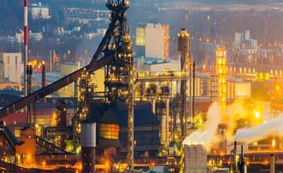
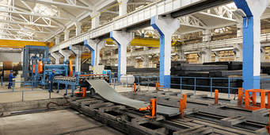
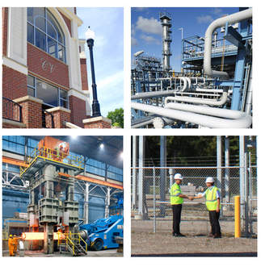
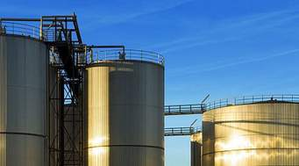
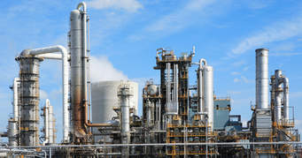
MANUFACTURING INDUSTRIES

Slide 2
Manufacturing.
Production of goods in large quantities after processing from raw materials to more valuable products is called manufacturing.
Manufacturing belongs to secondary sector in which the primary materials are processed and converted into finished goods.

Slide 3
Importance of Manufacturing
It helps in modernizing agriculture
It reduces heavy dependence on agricultural income by providing jobs in non-agricultural sectors.
Industries help in creating jobs and generating more income.
Export of manufactured goods expands trade and brings in foreign exchange.
.Industrial development brings prosperity to the country

Slide 4
Interdependence of Agriculture and Industry
Agro-industries have boosted agriculture by raising its productivity.
Industries depend on agriculture for their raw materials, e.g. cotton textile industry.
Industries provide many agricultural inputs like irrigation pumps, fertilizers, insecticides, PVC pipes, machines and tools, etc. to the farmers.
Development of different modes of transport by industrial sector has not only helped farmers to obtain agricultural inputs but has also helped them trade their products.

Slide 5
generate employ
ment
increase GDP
provide for the production of goods and provision of services
Contribution of industries to the National Economy
provide choices for consumers.
add to the country's foreign exchange.
Improve
country's infrastructure

Slide 6
Factors which Affect the Location of an Industry - Availability of:
Raw material
Labour
Power
Capital
Banking and insurance facilities
government policies.

Slide 7
Classification of Industries
Agro-based
Raw Materials
Mineral-based
Basic
Main Role
Consumer

Slide 9
Small-Scale
Capital Investment
Large-Scale
Heavy
Bulk and Weight
Light

Slide 10
Public Sector
Private Sector
Ownership
Cooperative Sector
Joint Sector

Slide 13
Thank you
Nancy George
AECS, Mysore

